Slide 1
Title: Climatic Changes ejnehiodhje

Slide 2



What is Climate Change?
Long-term shifts
Driving Forces
Temperature Rise
Changes in weather patterns over extended periods
Influenced by both natural events and human activities
Significant increase in global temperatures within the last 50 years

Slide 3




The Greenhouse Effect
2
Human Impact
Human activities increase gas levels dramatically
Heat Trapping
Greenhouse gases trap heat in the atmosphere
1
Rising CO₂ Levels
CO₂ levels now 30% higher than pre-industrial
3

Slide 4
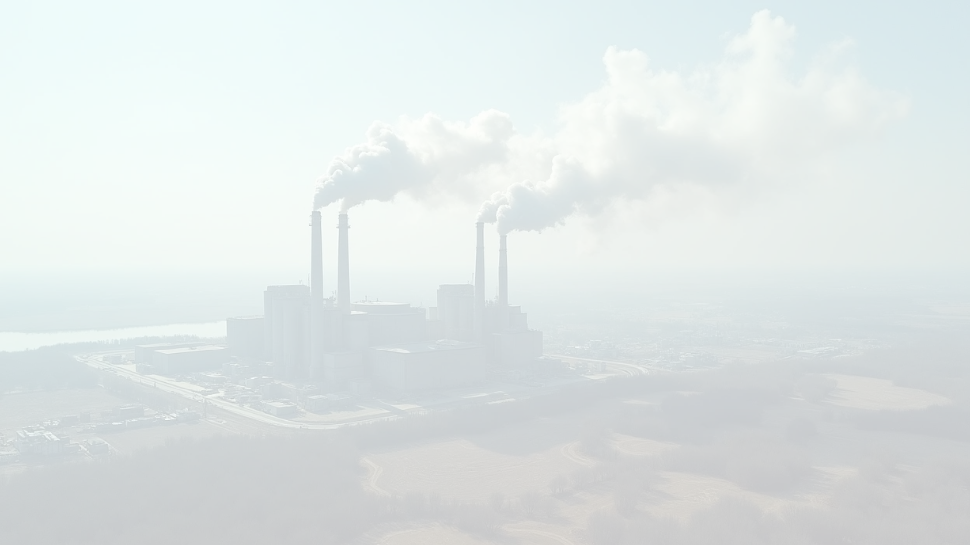
Major Human Causes of Emissions
75%
12 million hectares
Fossil fuel burning
Deforestation
75% emissions
12 million hectares lost annually
70%
50%
Agriculture
Transportation
Produces potent greenhouse gases
Contributes nearly half of emissions

Slide 5
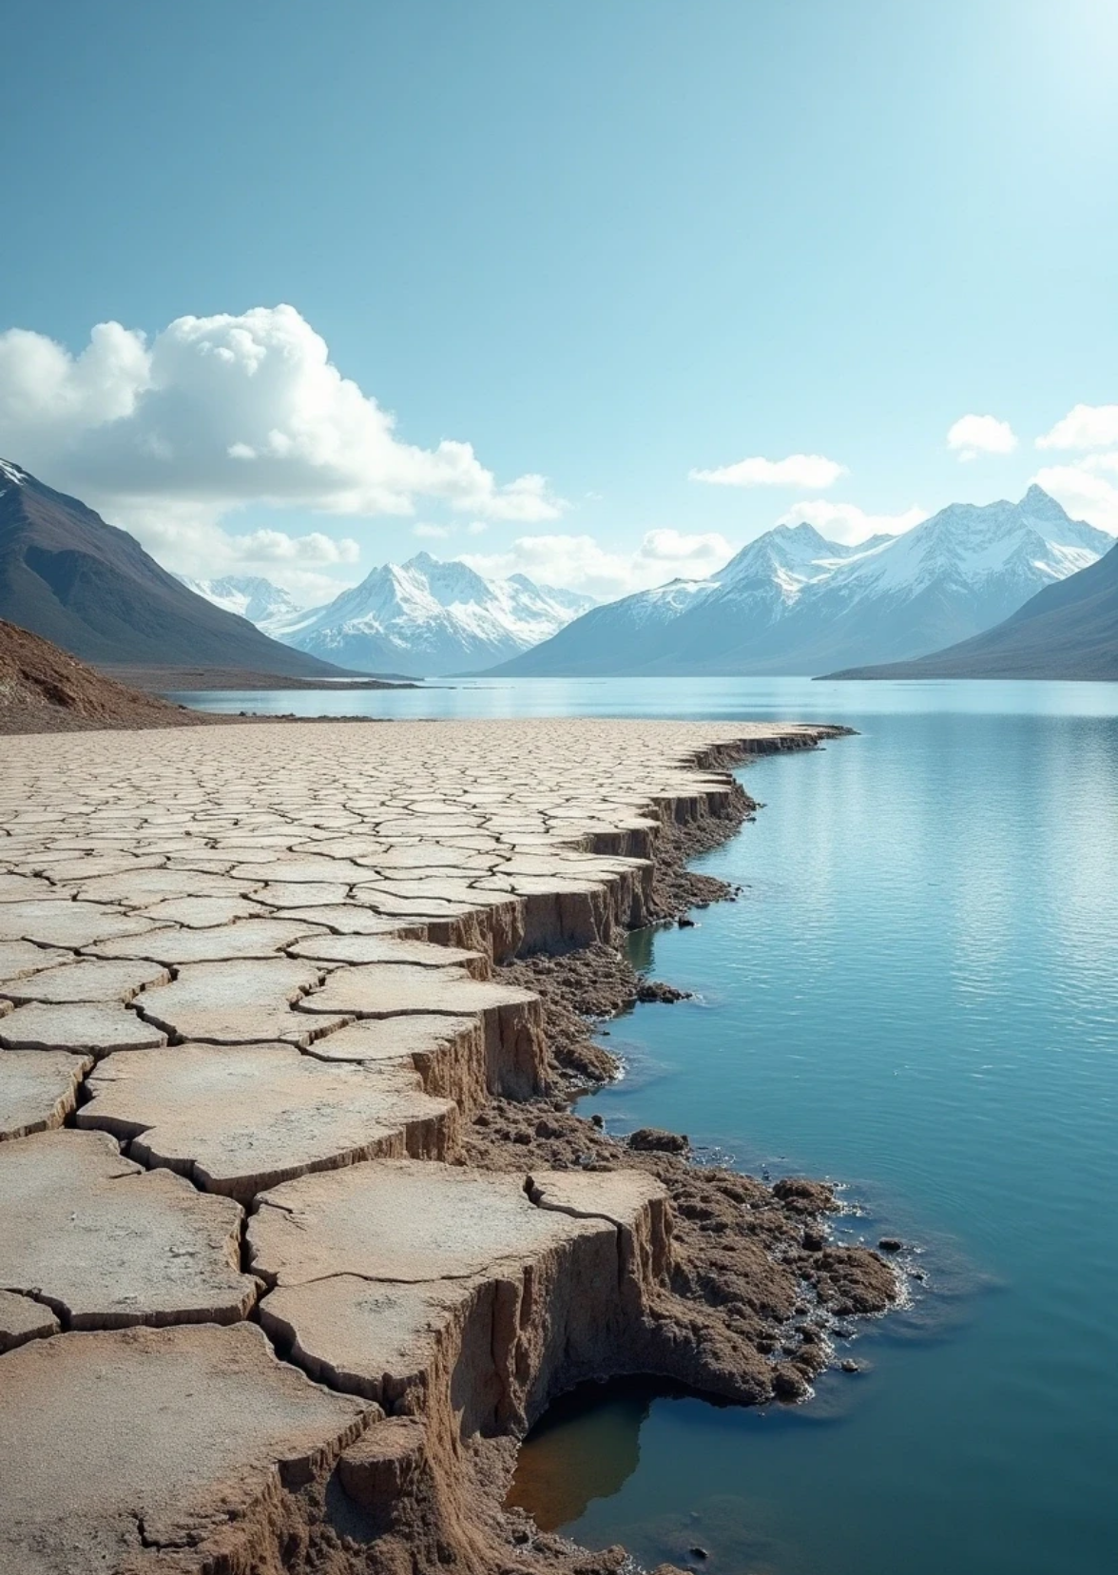


Alarming Impacts We Face
Rising Temperatures
Melting Ice
Severe weather events are on the rise.
Leads to significant sea level rise.
Increased Droughts and Floods
Loss of Biodiversity
Increases health risks and ecological imbalance.
Affecting agriculture and food security.

Slide 6




Global Efforts and Solutions
Reforestation Initiatives
Renewable Energy Growth
1
2
Absorbing CO₂ emissions
International Agreements
Innovative Agriculture Solutions
Paris Agreement
4
3
Reducing agricultural emissions

Slide 7


What Can We Do?
Reduce Carbon Footprints
Support Sustainable Policies
Raise Community Awareness
Invest in Clean Technologies

Slide 8
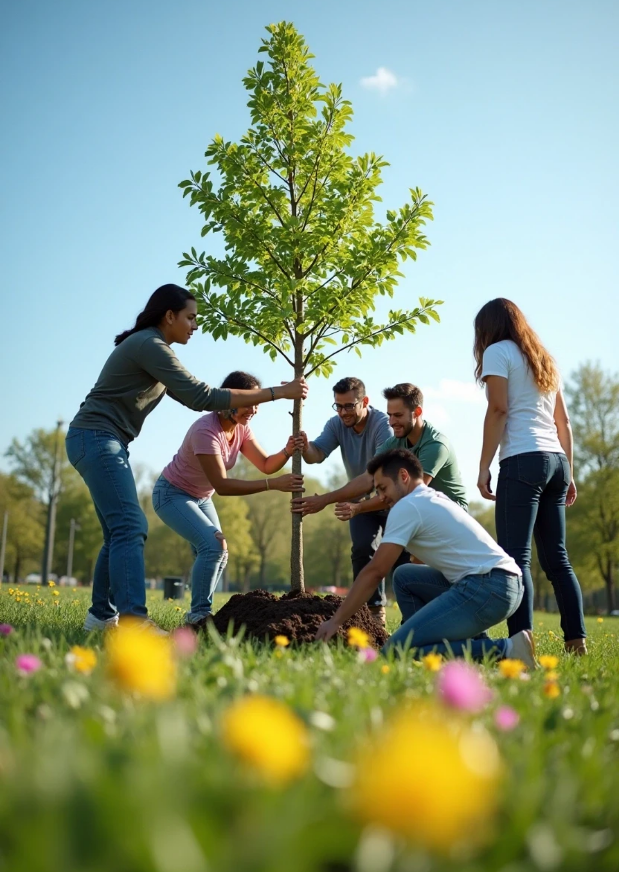
The Time to Act is Now
Climate Threat
Climate change threatens our future and health
Warming Impact
Every degree of warming matters
Collective Action
Together, we can protect our planet and future

Slide 9
Thank you

